Slide 1
UNIT3: Processes UNIT4: Communication
Distributed System |

Slide 2
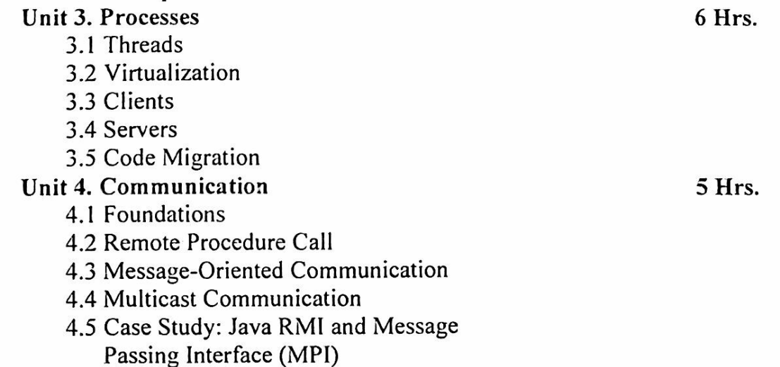

Slide 3
What is Process?
Processes are isolated units with their own memory and resources, suitable for running independent programs.
A Process is an instance of a computer program that is being executed. It contains the program code and its current activity. Depending on the operating system, a process can be made up of multiple threads of execution that execute instructions concurrently.
Key characteristics of a process include:
Isolation: Processes are isolated from each other. Each process has its own memory space and resources.
Resource Allocation: Processes are allocated separate resources by the operating system, including memory, file handles, and CPU time.
Execution: A process executes in its own address space and has at least one main thread of execution.
Communication: Inter-process communication (IPC) mechanisms are used for processes to communicate with each other since they do not share memory space.

Slide 4
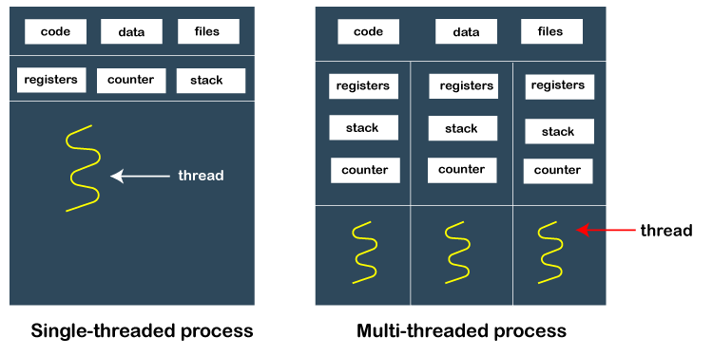

Slide 5
What is Thread?
Threads are lightweight units of execution within a process that share the same memory space, allowing for parallel execution and efficient resource usage within a single application.
A Thread is the smallest unit of processing that can be scheduled by an operating system. Threads are sometimes called lightweight processes because they share the same memory space and resources of their parent process.
Key characteristics of a thread include:
Shared Resources: Threads of the same process share the same memory space and resources (e.g., file descriptors, global variables).
Concurrent Execution: Multiple threads within the same process can execute concurrently, allowing for parallelism within a process.
Lighter Context Switching: Switching between threads is generally faster and more efficient than switching between processes because threads share the same memory space.

Slide 6
Aspect | Process | Thread
Definition | A process is an independent program in execution. | A thread is the smallest unit of execution within a process.
Memory Space | Has its own memory space; separate address space. | Shares memory space with other threads in the same process.
Resource Sharing | Does not share resources with other processes. | Shares resources with other threads of the same process.
Isolation | Processes are isolated from each other. | Threads are not isolated; they share data and resources.
Communication | Requires Inter-process Communication (IPC) mechanisms. | Direct communication is possible since threads share memory.
Overhead | Higher overhead due to the need for separate memory allocation. | Lower overhead; less memory allocation required.
Context Switching | More expensive and slower due to the need to switch memory maps. | Less expensive and faster due to shared memory.
Creation Time | Takes more time to create compared to threads. | Takes less time to create compared to processes.
Stability | A crash in one process does not affect other processes. | A crash in a thread can potentially crash the entire process.
Example Use Case | Running different applications (e.g., a web browser and a text editor). | Performing multiple tasks within the same application (e.g., multiple tabs in a web browser).

Slide 7
Why Process and Thread are useful in Distributed System?
Processes in Distributed Systems
Isolation and Fault Tolerance: Processes provide isolation between different components of a distributed system. If one process crashes, it does not affect other processes. This isolation enhances fault tolerance and makes the system more robust.
Resource Allocation: Processes allow for controlled allocation of resources. Each process can be given specific resources, which can be managed independently by the operating system.
Security: Processes run in separate memory spaces, which helps in maintaining security boundaries. Sensitive data in one process cannot be directly accessed by another process.
Scalability: Distributed systems often need to scale across multiple machines. Processes can be distributed across different nodes in a network, enabling horizontal scaling and better utilization of distributed resources.
Inter-process Communication (IPC): Processes use IPC mechanisms (such as message passing, sockets, or remote procedure calls) to communicate with each other. This is fundamental in distributed systems where processes running on different machines need to coordinate and exchange data.

Slide 8
Threads in Distributed Systems
Concurrency: Threads allow multiple tasks to be performed concurrently within the same process. This is essential in distributed systems for handling multiple client requests simultaneously, improving responsiveness and throughput.
Resource Sharing: Threads within the same process share memory and resources, making it easier to manage shared state and data. This is useful in scenarios where tasks need to collaborate or share intermediate results.
Efficiency: Threads are more lightweight compared to processes, with lower overhead for creation and context switching. This efficiency is beneficial for distributed systems where performance and resource utilization are critical.
Parallelism: Threads can run on multiple processors or cores, enabling parallel execution of tasks. This parallelism is important for distributed systems that need to process large volumes of data or perform compute-intensive tasks.
Responsiveness: In interactive distributed applications, threads can be used to handle different parts of the application (e.g., user interface, network communication, and background processing) simultaneously, improving overall responsiveness.

Slide 9
Use Cases in Distributed Systems
Web Servers: A web server might use multiple processes to handle different clients and multiple threads within each process to manage various tasks such as handling requests, processing data, and communicating with databases.
Microservices: Each microservice in a distributed system can run as a separate process. Within each microservice, multiple threads can be used to handle incoming requests concurrently, perform background jobs, or manage asynchronous tasks.
Database Servers: Database systems often use threads to handle multiple client connections and queries simultaneously, improving throughput and responsiveness.
Big Data Processing: Distributed computing frameworks like Hadoop and Spark use processes to distribute tasks across multiple nodes in a cluster. Each node may run multiple threads to process chunks of data in parallel, enhancing performance and scalability.
Together, processes and threads enable distributed systems to be more robust, scalable, efficient, and responsive, meeting the complex demands of modern distributed applications.

Slide 10
Virtualization in Distributed System
A virtual resource, such as a server, desktop, operating system, file, storage, or network, is created through the process of virtualization.
Virtualization’s main objective is to manage workloads by fundamentally altering conventional computing to make it more scalable.
It is possible to think of threads and processes as ways to do multiple tasks simultaneously. We can construct (parts of) programs that appear to run simultaneously thanks to them. Naturally, this simultaneous execution is fiction on a single-processor computer.
A single thread or process will only have one instruction at a time because there is only one CPU. The illusion of parallelism is achieved by moving back and forth quickly between threads and processes.
Resource virtualization is a term used to describe the difference between having a single CPU and being able to pretend there are multiple CPUs.

Slide 11
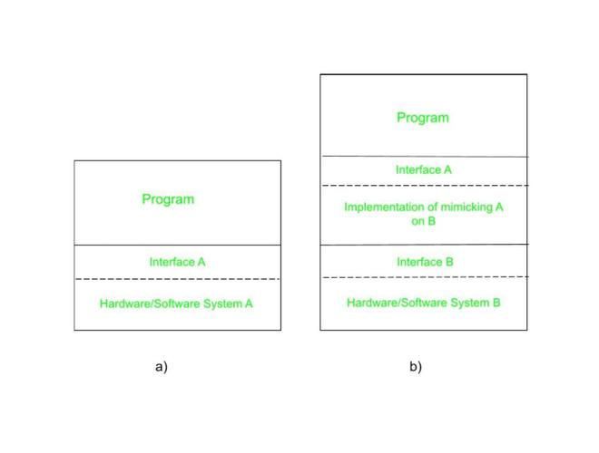
The Role of Virtualization in Distributed Systems:
Every (distributed) computer system actually provides a programming interface to higher-level software, as can be seen in the below Fig (a).
There are many various kinds of interfaces, from the fundamental instruction set that a CPU provides to the enormous selection of application programming interfaces that are included with many modern middleware systems.
To emulate the behavior of another system, virtualization essentially involves extending or replacing an existing interface, as seen in Fig (b).
By effectively having each application run on its own virtual computer, possibly with the associated libraries and operating system, which in turn run on a common platform, virtualization can help minimize the diversity of platforms and machines. A high degree of portability and flexibility is offered by virtualization.

Slide 12
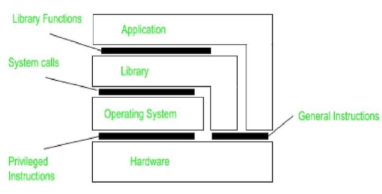
Architectures of Virtual Machines :
Understanding the variations in virtualization requires an understanding of the common four types of interfaces that computer systems provide, at four different levels.
A point of contact between hardware and software, made up of commands that can be executed by any application.
A point of contact between hardware and software that is made up of machine instructions that are only accessible to privileged programs, such as an operating system.
An operating system interface that is made up of system calls.
An interface made up of library calls, which often constitutes an API (application programming interface) (API).
The following figure illustrates these various categories. The goal of virtualization is to replicate the functionality of these interfaces.

Slide 13
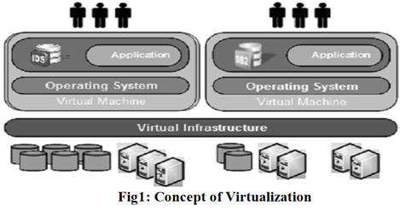
Virtualization can happen in one of two ways. First, we can create a run-time system, which effectively offers an abstract instruction set for use in running programs. Instructions can be mimicked, as is done when running Windows applications on UNIX platforms, or they can be interpreted, as is the case for the Java runtime environment. Keep in mind that in the latter scenario, the emulator will also need to replicate how system calls behave, which has historically proven to be anything but simple. This kind of virtualization emphasizes that virtualization is primarily only done for a single process by referring to a process virtual machine.
An alternative method of virtualization is to offer a system that is effectively constructed as a layer that entirely shields the original hardware while exposing the entire instruction set of that hardware (or other hardware) as an interface.

